Slide 1

San Francisco Crime Analysis
Final Presentation
Team 10
Ning Huang 001839327
Yixuan Wang 001494410

Slide 2
01
Overview
We'll explore the 12-year crime report for San Francisco, build models to classify the types of crime and predict the crime occurrences for specific periods and locations.
Data Models Data Web

Slide 3

02
Data Resources
https://www.kaggle.com/c/sf-crime/overview
Dates - timestamp of the crime incident
Category - category of the crime incident
Descript - detailed description of the crime incident
DayOfWeek - the day of the week
PdDistrict - name of the Police Department District
Resolution - how the crime incident was resolved
Address - the approximate street address of the crime incident
X - Longitude
Y - Latitude
This dataset contains incidents derived from SFPD Crime Incident Reporting system. The data ranges from 1/1/2003 to 5/13/2015.
Total number of rows: 1762313

Slide 4
03
Goals
1
2
3
Analyzing the crime data to reveal the frequency of each type of crime occurrences, and explore its relationship with other factors, like time periods and locations.
Building model to classify and predict crime type for helping police responds faster and more effective, and reduce the harm of crime incident.
Implementing a user-friendly system for providing people a convenient way to check the crime occurrences in specific spots, and make them keep conscious of dangers.

Slide 5
04
Methodology
01
Data Processing
Read and explore Data
Understanding the features and the problems
Clean the Data with Spark
02
Random Forest
Use Random Forest algorithm with Spark to determine the crime type based on the crime Incident records.
03
Logistic Regression
Implement Logistic Regression by using TF-IDF Features to do multi-class text classification with Spark
04
Data Visualization
With Play framework, users can interact with system to search data and will get results to prediction

Slide 6
05
Machine Learning
Crime Type
Classification
Data Process
Data Preprocessing and Loading; Outliers Clean;
Feature Enrichment and Feature Engineering
S
Using Random Forest model to classify/ predict the crime type for each crime incident record.
W
T
Crime Description Classification
O
Output Data
Applying Logistic Regression by using TF-IDF Features to analysis the crime description and classify the crime type
Form the output result data from above processes and make them flow into the UI interface/ web.

Slide 7
05
Machine Learning Data Processing
FIRST
SECOND
THIRD
FOURTH
Data Load
Data Clean
Feature Enrichment
Feature Engineering
Read the train set, test set data and other necessary dataset, transfer them to spark dataframes.
Drop duplicated crime record in raw dataset; Detect the outliers and remove them.
Scrapping useful data source from other websites for enriching the features. Like weather, sunset and sunrise time, holiday info and so on.
Encoding categorical features; Wrap all features into a vector, Indexing the target variable and pipeline the whole process.

Slide 8
05
Machine Learning Data Processing
Data Load
Data Clean
Feature Enrichment
Feature Engineering
Loading Data:
Train Data
Test Data
Weather Data
Sunset/Sunrise Data
Reclassify Data
Deleting Outliers:
SF Latitude > 50
Deleting Duplicates:
Incident Number should
be unique.
Creating Features:
Weekday
Weather
Temperature
Street Name
AddressType
IsNight
IsWeekend
Season
Pipeline:
RF -
StringIndexer()
VectorAssember()
IndexToString()
TF-IDF -
StopWordsRemover()
HashingTF()
IDF()

Slide 9
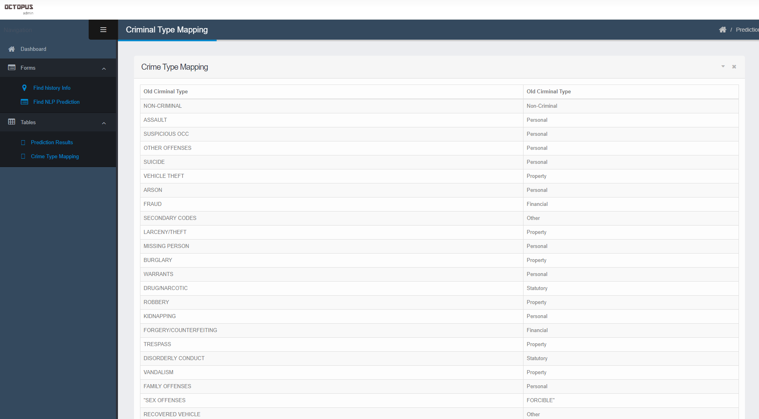
05
Machine Learning Reclassify Data
Because the number of features which Kaggle dataset provided is far less than the number of classes. We tried to reclassify the crime category based on:
https://www.justia.com/criminal/offenses/
Before: 39 classes
After: 5 classes
Make model more reasonable!

Slide 10
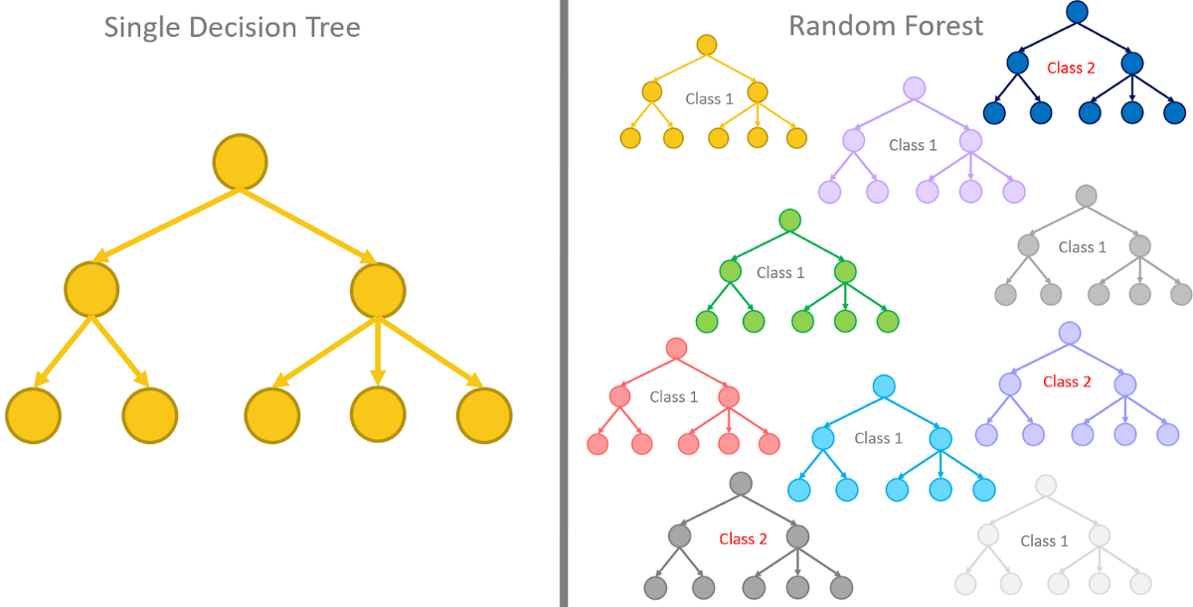
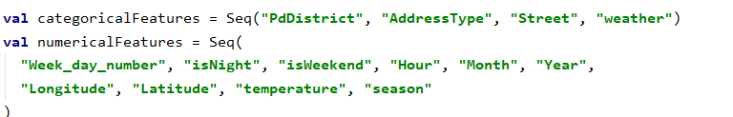
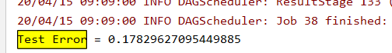
05
Machine Learning Crime Type Classification
Random Forest
Ensembling Learning
Naturally fit for Multi-Class Classification Problem
Easy Tackling Data Imbalance
Good Model Performance - fast and accurate

Slide 11
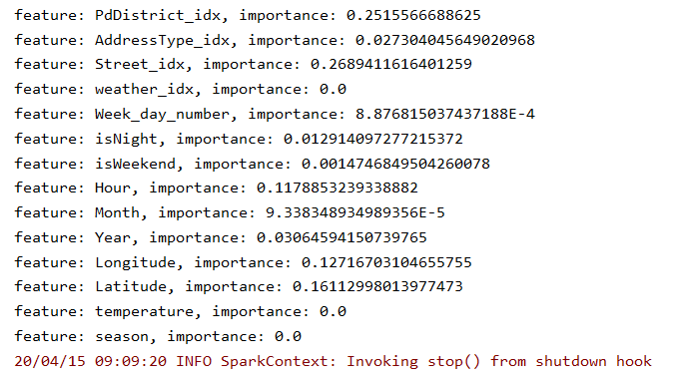
05
Machine Learning Crime Type Classification
Random Forest
Ensembling Learning
Naturally fit for Multi-Class Classification Problem
Easy Tackling Data Imbalance
Good Model Performance - fast and accurate

Slide 12
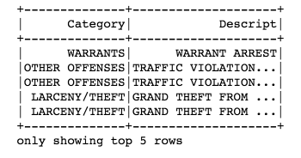
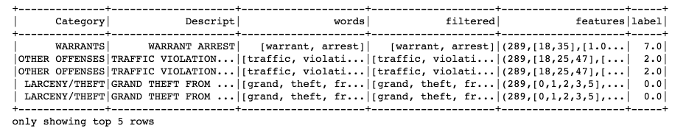
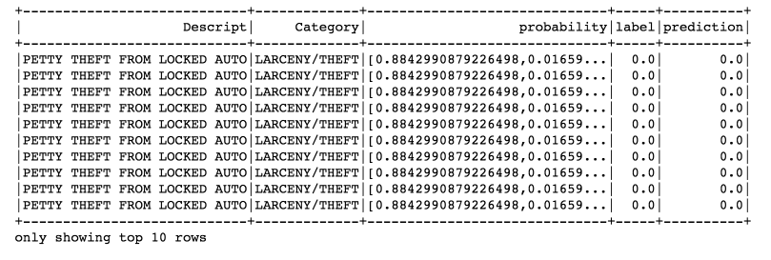
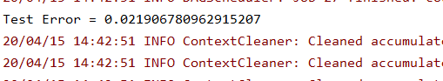
05
Machine Learning Crime Description Classification
TF - IDF
A numerical statistic that is intended to reflect how important a word is to a document in a collection or corpus.
Often be used as a weighting factor in searches of information retrieval, text mining, and user modeling.
The TF–IDF value increases proportionally to the number of times a word appears in the document and is offset by the number of documents in the corpus that contain the word, which helps to adjust for the fact that some words appear more frequently in general.

Slide 13
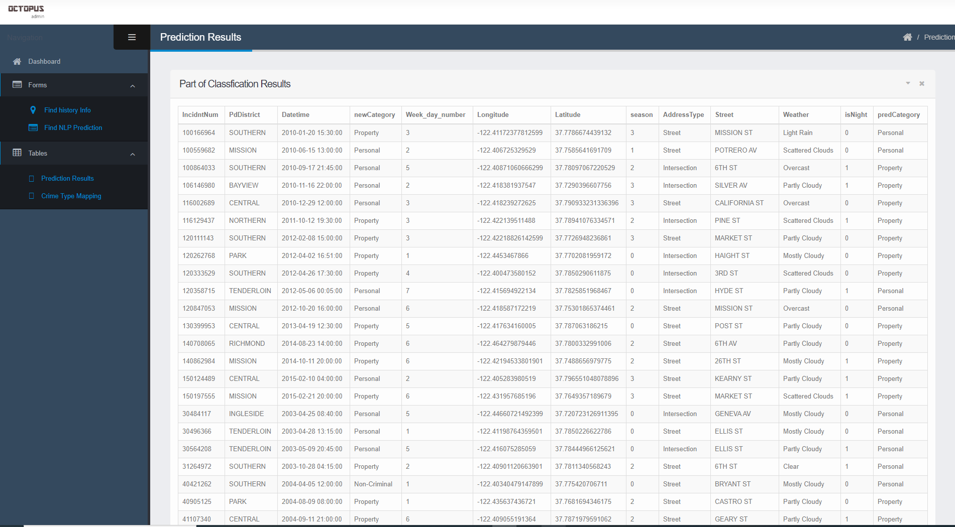
05
Machine Learning Output Data
Crime Type
Classification

Slide 14
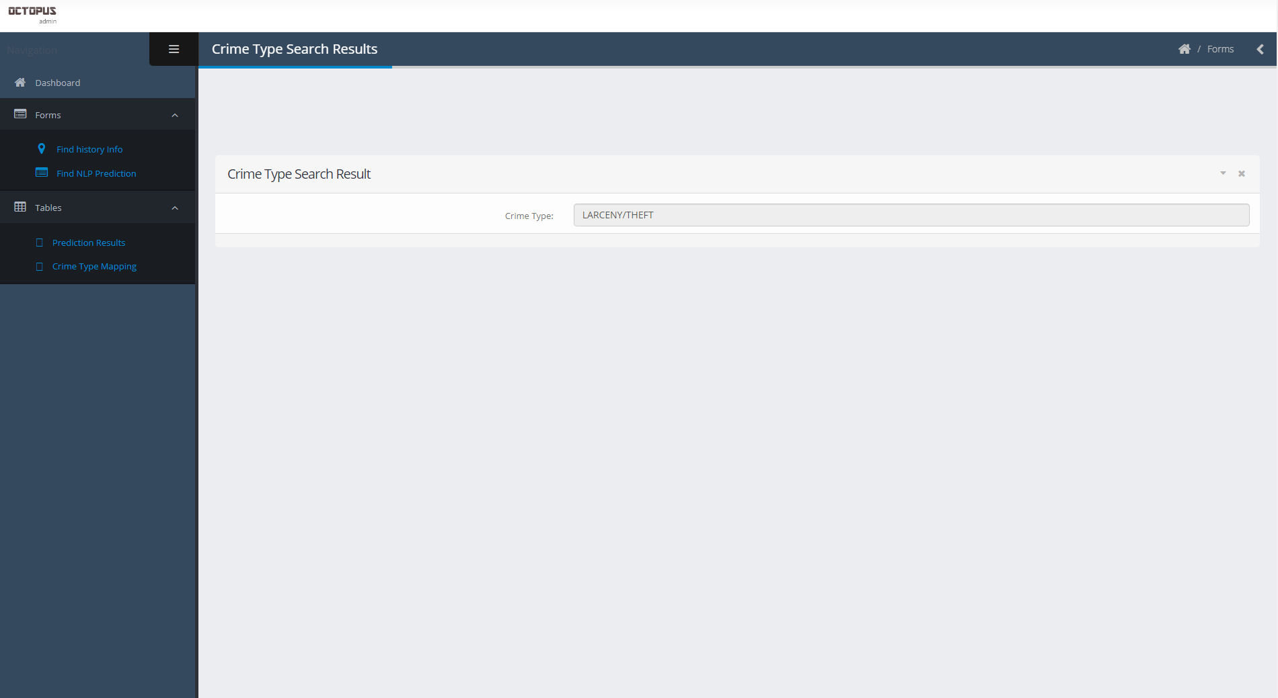
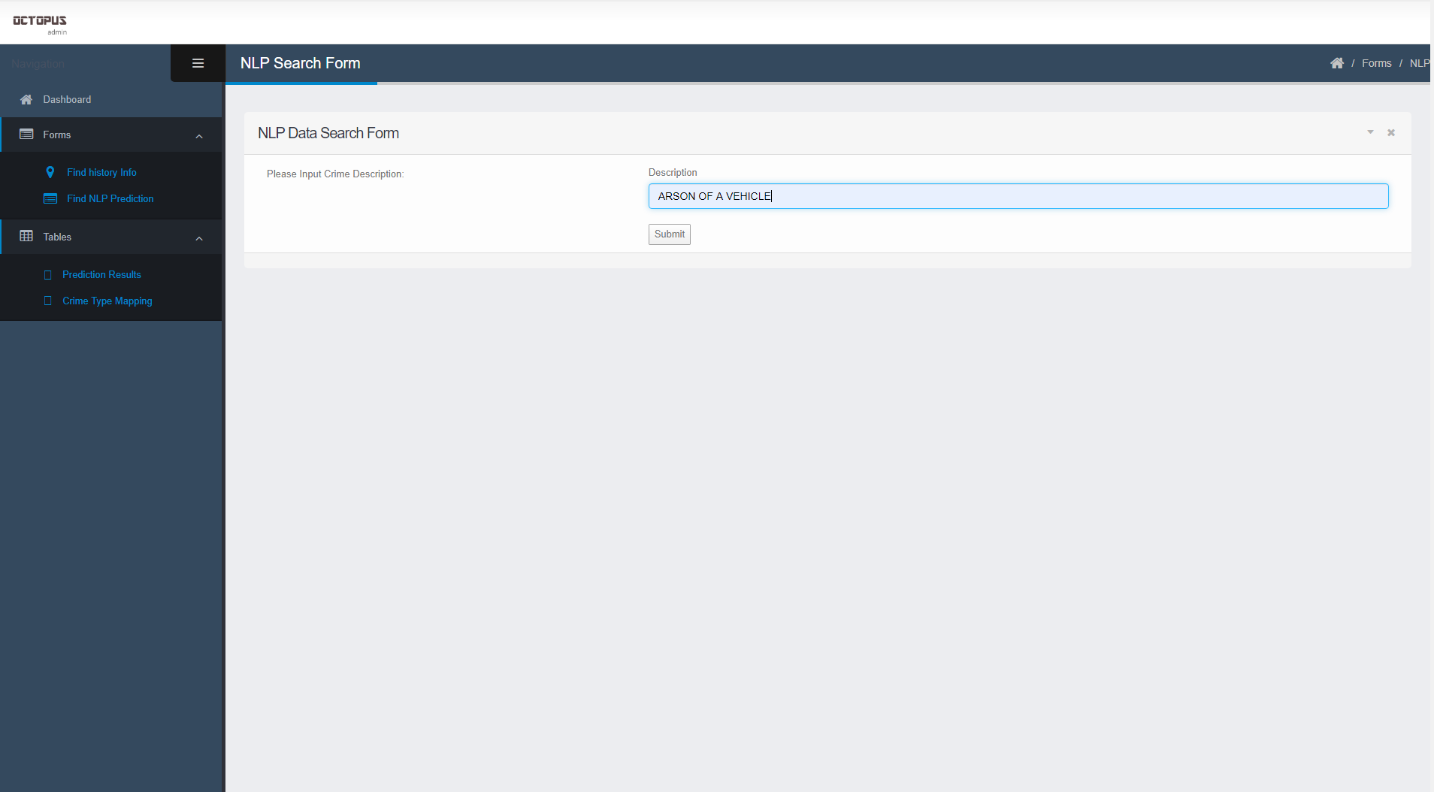
05
Machine Learning Output Data
Crime Description
Classification

Slide 15
06
Use Cases
System can analyze the data to show the dangerous place/ district in the specific time periods
Visitors can input the area name to check the crime occurrences, system will show the crime incident information in that area
Users can search for crime records, system will get back to them the records which matched for those inputs information.
System runs crime records data (Machine Learning) model and predicts the crime types of those records.

Slide 16

07
User Interface
The Play FrameWork is MVC framework. This part is really time-consuming. Totally new to us, such as different form action handling, error handling, the concepts of Request Mapping and Dependency Injection.
We built user interface base on this framework, and we’d like to quickly walk through the demo of these interfaces.

Slide 17
07
Demo
User Interface in the project includes five parts:
Data Visualization: Via machine learning algorithms and Spark, we made some sample histogram and pie charts to show data analysis results.
Data Searching: Users can input some condition to get historical crime records and these information will be displayed through map with marker presenting the crime occurrence date, street, weather and crime type.
Crime Type Match: This function is developed for police man. When resident call 911, they will provide some crime description. So this can help policeman to know the criminal type immediately, which can help them to prepare well.
Csv file Displaying: This part is mainly for displaying our prediction/ classification results, and user can download CSV file to get more information.
Crime Type Mapping: The original datasets in the Kaggle have 39 crime types which make prediction badly performed. So we map the old crime type to new type depending the official guidance attached by the footer of the website.

Slide 18
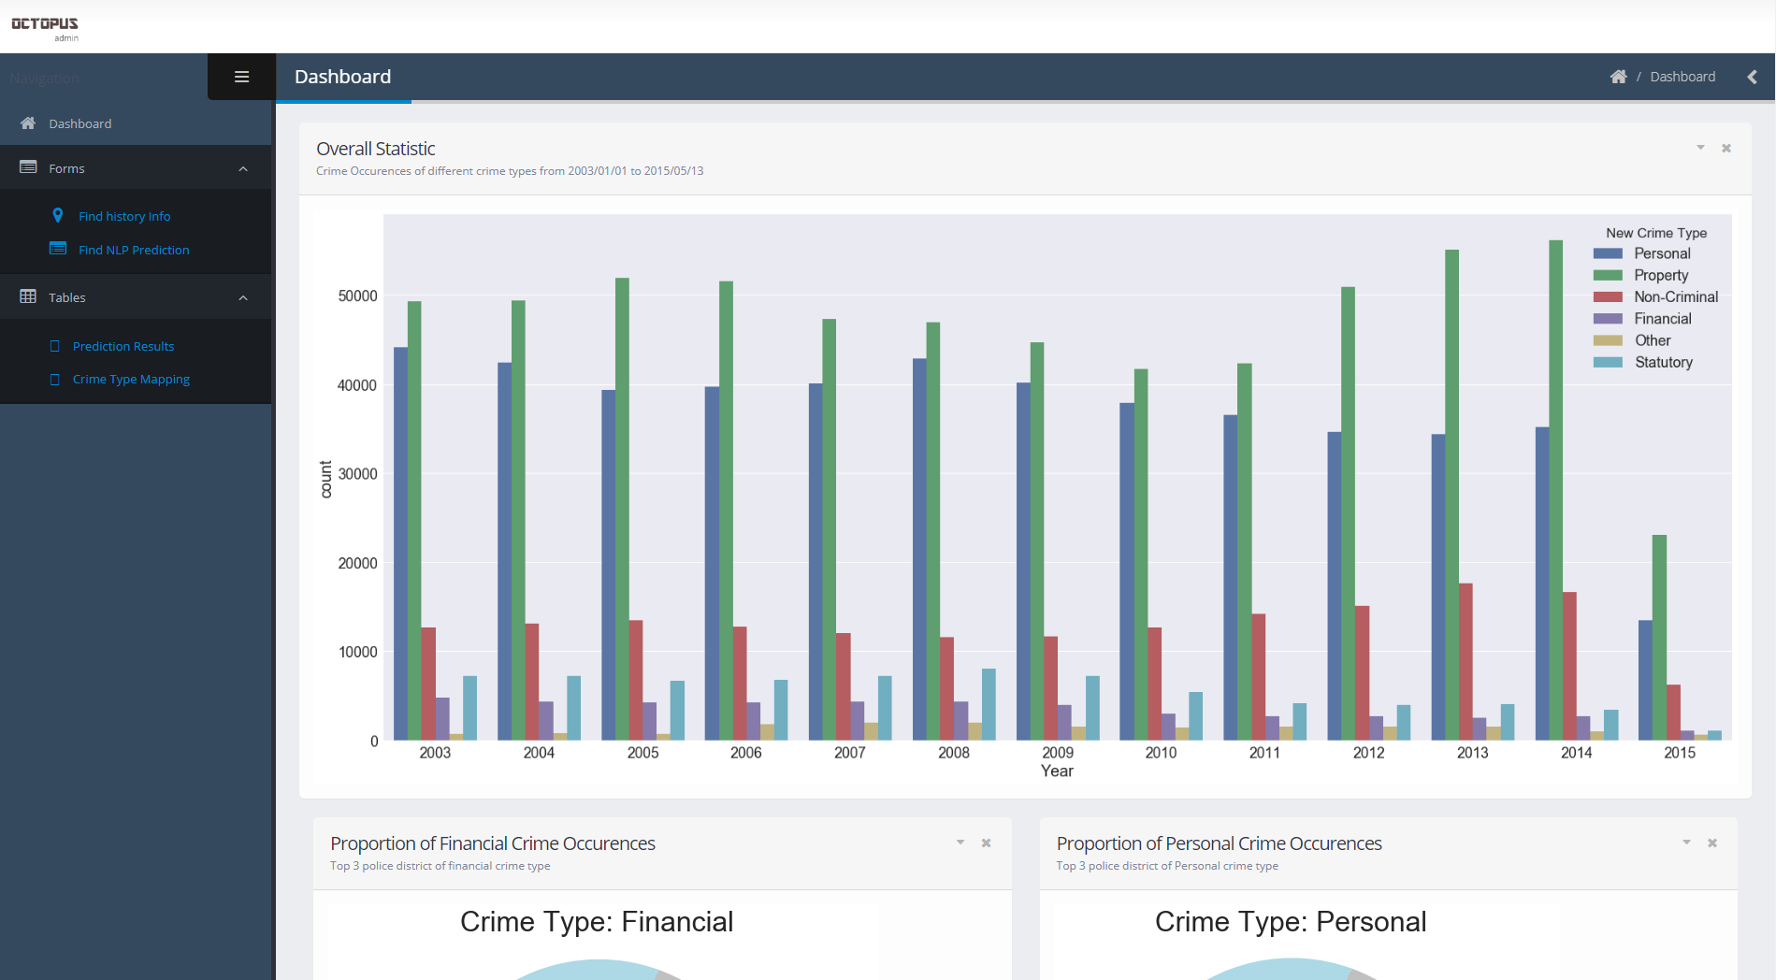
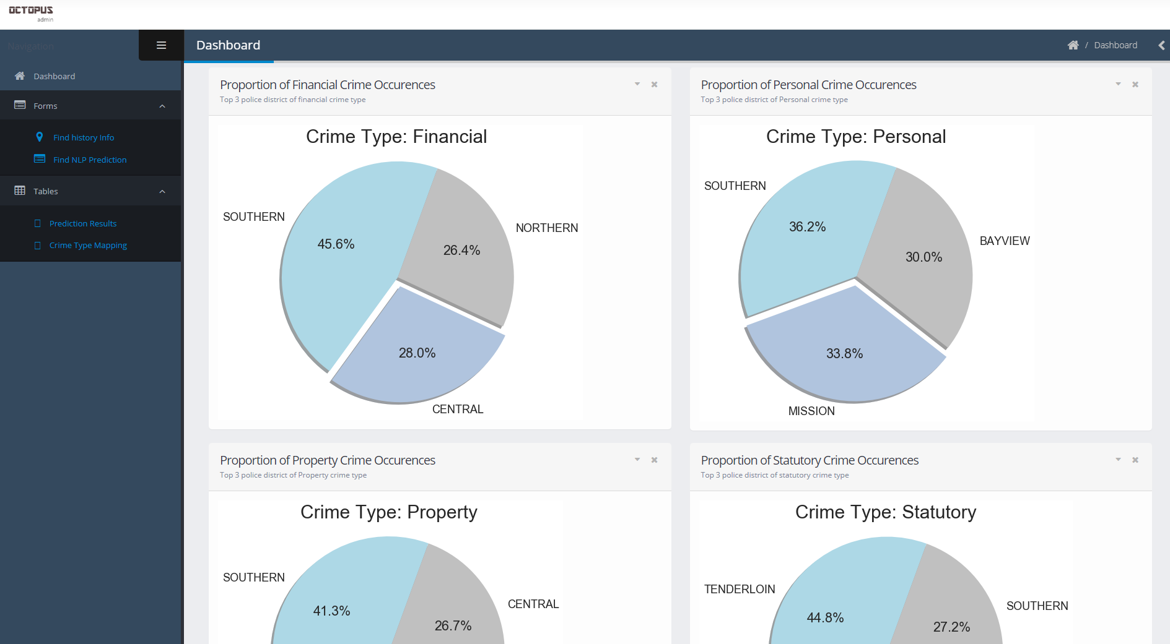
07
Demo Data Visualization

Slide 19
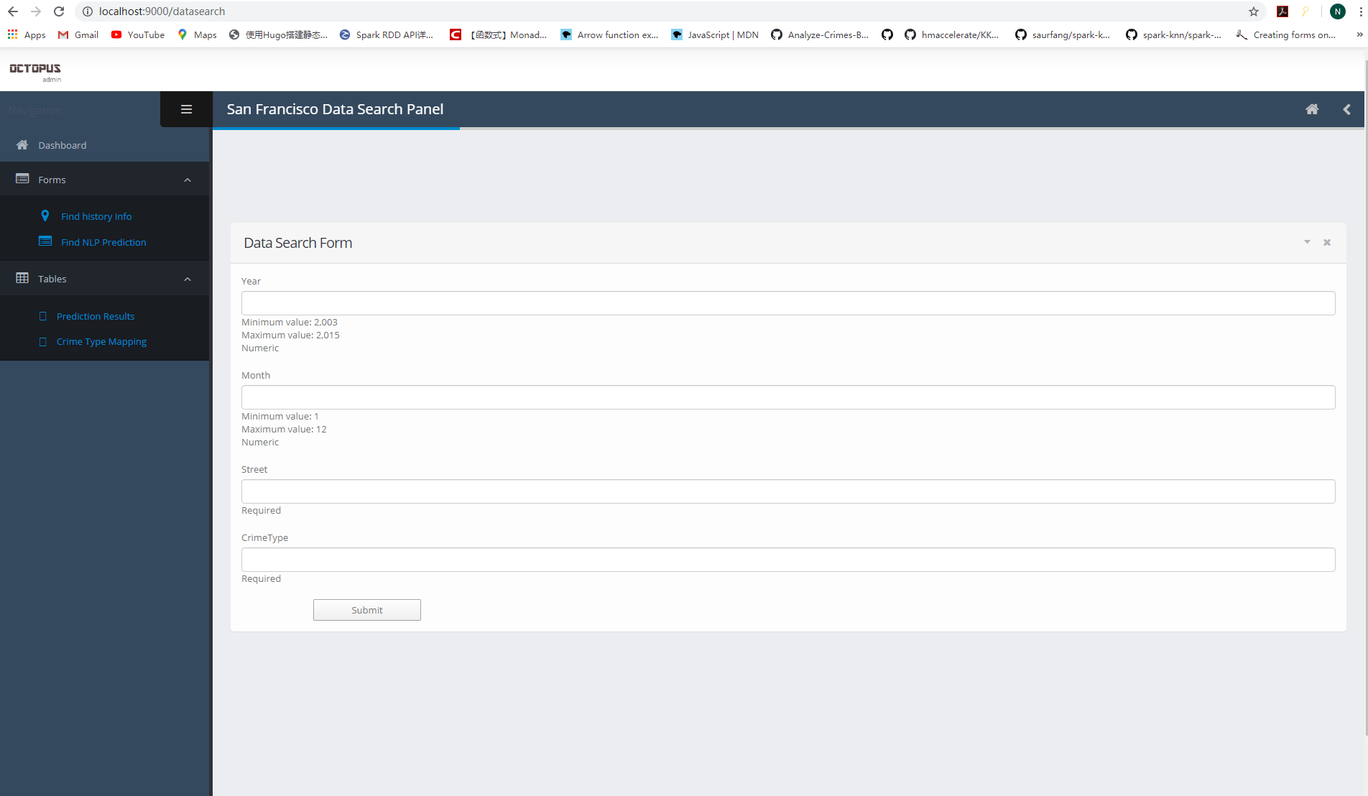
07
Demo Data Searching
There are some input data restriction.
It won’t show the result if visitors did not input the correct condition.

Slide 20
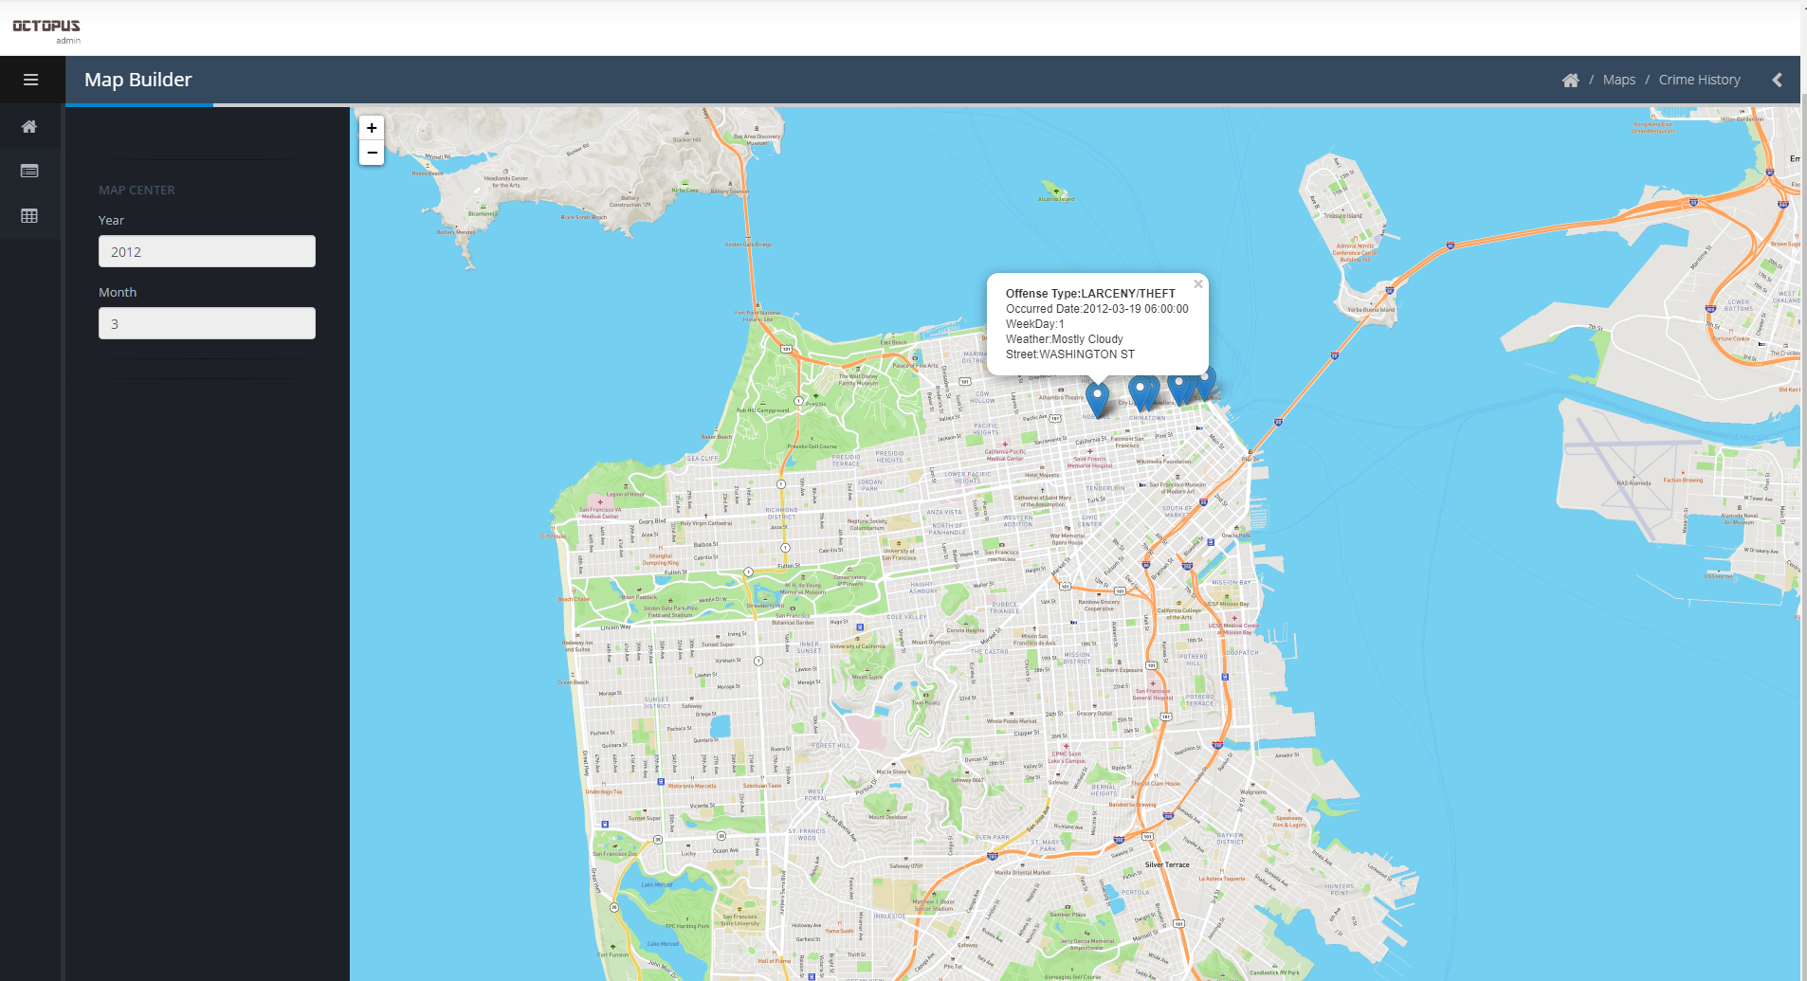
07
Demo Data Searching

Slide 21
07
Demo Crime Type Match
Input the crime description
Return the matched crime category for the input description

Slide 22
07
Demo Csv File Display

Slide 23
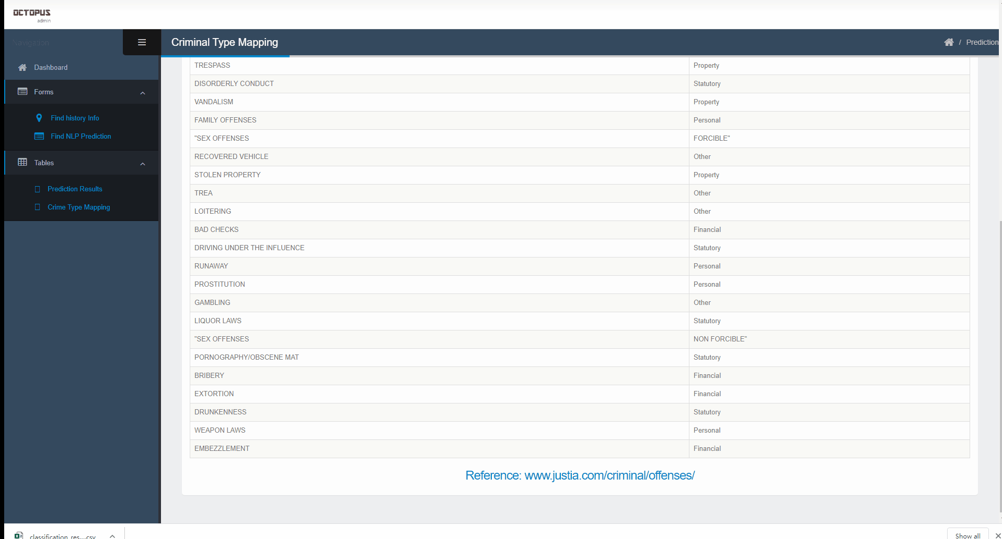
07
Demo

Slide 24
08
Acceptance Criteria
Level 1 Criteria
The responding time of Data Searching Function should be within 3 seconds
Level 2 Criteria
The test error of the description text multi-class classification should be less than 5%
Test Error 2%
Level 3 Criteria
The accuracy of crime type classification should be higher than 80%
Accuracy 81%

Slide 25
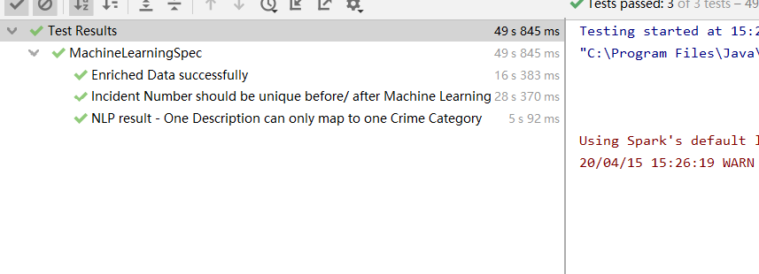
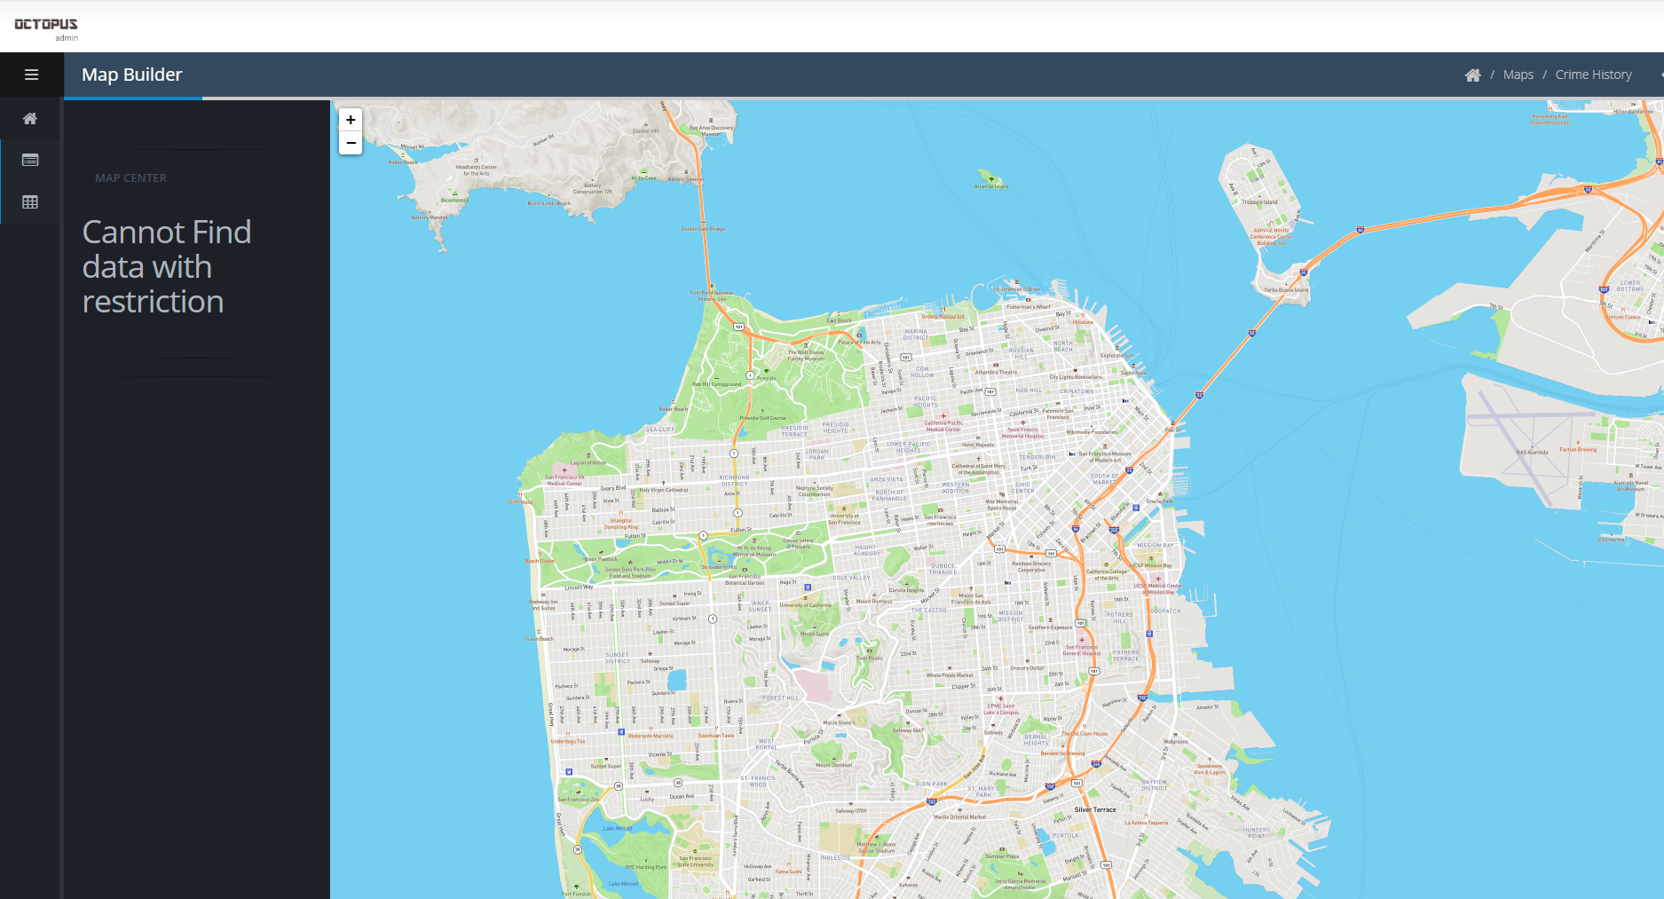
09
Unit Test

Slide 26
10
Program Details
Code Language and Framework
Spark, Scala and Play framework to display visualiation and interaction
Details
Github Repo Link:
https://github.com/HuangNing2024/CSYE7200
Our dataset is too large, git cannot allow uploading files more than 100MB, so we decide to upload all data source in the google drive. If you would like to run our program, you need to download data from the attached link. CSYE7200-SFCrime-Dataset

Slide 27
10
Program Details Data Source info
Machine Learning
Data Seaching Systems
train.csv
test.csv
weather.csv
sunsetrise.csv
data_reclassify.csv
testEnrichedData.csv (for Unit Test)
nlp_result.csv (line 160)
classification_result.csv (line 51 82)
searchingData.csv (line 121)
reclassify.csv (line65)
data.csv (line136)
“line xxx” means the line number in the homeController.scala file.
Attention: If you want to run the program, you need the revise the file path in the code after downloading the dataset from google drive.

Slide 28

Thank you

